Slide 1

SMART INDIA HACKATHON 2026
TITLE PAGE
Problem Statement ID - SIH26227
Problem Statement Title - Semantic
Retrieval and Multi-Temporal Change
Analysis of Satellite Imagery
Theme - Space Technology
PS Category - Software
Team ID - 136055
Team Name (Registered on portal) – Byte Bandits

Slide 2
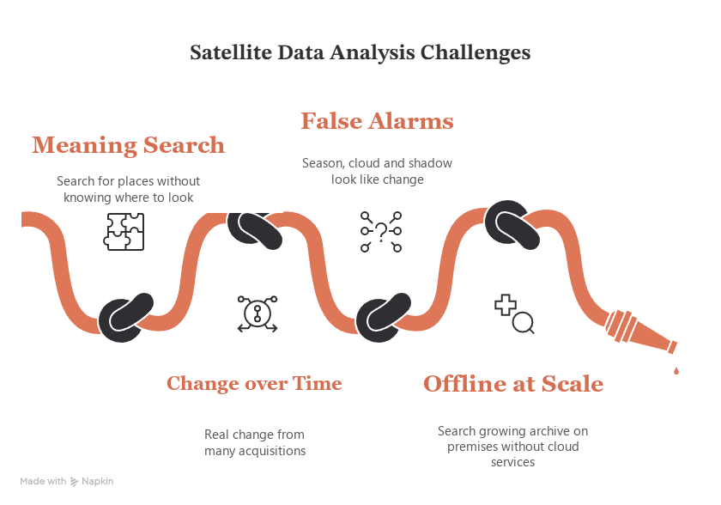
SatQuery ARC
Archive Search & Verified Change
Byte Bandits
Innovation
Uniqueness
Proposed Solution
Problem-Solution Flow
Semantic hybrid search
Text, image and similar site
search with AOI, date and
sensor filters
In contrast to metadata-only catalogues,
SatQuery searches the archive by
meaning: free text, an example tile
or "find more like this".
Every potential change is checked
for season, cloud and misregistration
prior to review by an analyst, fully offline.
SIH Problem
Existing Solution
Need
Limitation
Search a growing
Catalogues only
Compositional query
"Newly built near a river" into
object, time and location checks
multi-sensor archive
match metadata;
by meaning and by
change tools generate
change, fully
false positives.
on-premises.
Dated change analysis
Type and dating of change to
the first usable image
showing it
False-alarm firewall
Filters out alerts caused by
season, bad weather and
misregistration
Research Gaps
Analyst Feedback Loop
Confirm or reject; every decision
is audited and re-ranks the queue
Foundation model search
is seldom georeferenced,
filterable, offline and
Sovereign, incremental index
All models local; HNSW index
builds incrementally, no rebuild
or external calls
auditable all together.
Solution

Slide 3













TECHNICAL APPROACH
Byte Bandits
Technology Stack
SatQuery Arc: Search Widely, Verify First
Frontend
TILE &
EMBED
REVIEW & EXPORT
React JS
Vite JS
INGEST
Multi-scale tiles →
SEARCH &
Ranked review queue,
GeoTIFF or COG from
RemoteCLIP for text,
DISCOVER
before/after chips,
Backend
Sentinel-1/2, Landsat
DINOv2, SSL4EO-S12
confirm / reject →
& high-res; metadata,
for image, MSI, SAR;
Text or image query →
re-rank; GeoJSON, PDF
checksums preserved
ONNX on local CPU
ANN, re-rank, clusters
with full provenance
Python
Pydantic
AI & Deployment
QUALITY
HYBRID
VERIFY
GATE
INDEX
CHANGE
Cloud, haze, snow,
PostGIS + pgvector
Seasonal time-series
Pytorch
shadow masks; CRS,
HNSW with place, time,
breaks + confounder
GeoSpatial
GSD, co-registration,
sensor, quality; adds
tests → type, earliest
radiometric
without a rebuild
date, confidence
normalisation
Workflow

Slide 4
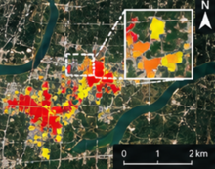
FEASIBILITY AND VIABILITY
Byte Bandits
Feasibility Analysis
Potential Challenges
Solutions
Implementation Roadmap
Technical Feasibility
Seasonal false change
Same-season baselines
Build Stages
Prototype already operates
on gate, change & audit
Clouds, haze, snow
P3 –
Air-gapped bundle,
and shadow
Per-pixel quality mask
Deployment
eval report,
Datasets ready
scale test
Sentinel-1/2, OSCD,
Misregistration &
Co-registration &
normalization
P2 –
Clusters, review
SpaceNet-7, RSITMD
sensor differences
Differentiator
queue, feedback
Vague free text queries
Query plan + feedback
P1 – Trust
Time-series change +
Layer
false-alarm firewall
Modular models
Geospatial processing
Air-gap & model licenses
Screened offline bundle
Embeddings, index,
RemoteCLIP, DINOv2,
STAC metadata, CRS,
P1 - Core Search
text & image search
SSL4EO-S12 & OWLv2
GSD & quality masks
Disagreement Map
P0 –
COG ingest,
Routes a change to review when sources
disagree (optical vs. SAR vs. index vs. model).
Foundation
quality masks
Change verification
Analyst validation
Persistence + confounder
Confirm/reject decisions
tests + calibration
Re-ranking & re-calibration
Agreement
Disagreement
Uncertain
Feasibility

Slide 5
IMPACT AND BENEFITS
Byte Bandits
IMPACT of Geo-Intelligence
Baseline Comparison with Existing Solutions
INFRASTRUCTURE
DISASTER
MONITORING
TERRAIN
SatQuery ARC
Research
Existing Solutions
New roads, bridges and
INTELLIGENCE
(RS-CLIP)
(Catalogue/CD)
RESPONSE
construction, dated
Land clearance,
Flood & damage extent,
river-course and
SAR can see through clouds
route changes
100
GEO-
ENVIRONMENTAL
MONITORING
Semantic Retrieval
70
INTELLIGENCE
30
Discovery of sites of interest
Water extent, forest destruction,
growth of glacial lakes
over large areas
100
from one example
Change Analysis
33
PS 26227 Capability
50
Fewer False Alarms
Search by Meaning
92
Confounds filtered out
before inference
Find sites without knowing
False-alarm Control
8
where to look first.
42
100
Analyst Workflow
0
Full Provenance
Analyst Trust
13
Scene, model and
processing path recorded
BENEFITS
Before/after comparison,
100
calibrated confidence,
Offline & Scale
30
audit-trail of decisions.
50
0
10
20
30
40
50
60
70
80
90
100
Temporal Intelligence
Sovereign & Offline
Coverage = proportion of the 23 sub-requirements in
PS 26227 §2.2-2.3 each approach satisfies (full = 1,
partial = ½). SatQuery ARC = planned final scope.
Coverage (%)
Dates changes to the
Air-gapped; no data
earliest available image
leaves the building
Impact

Slide 6
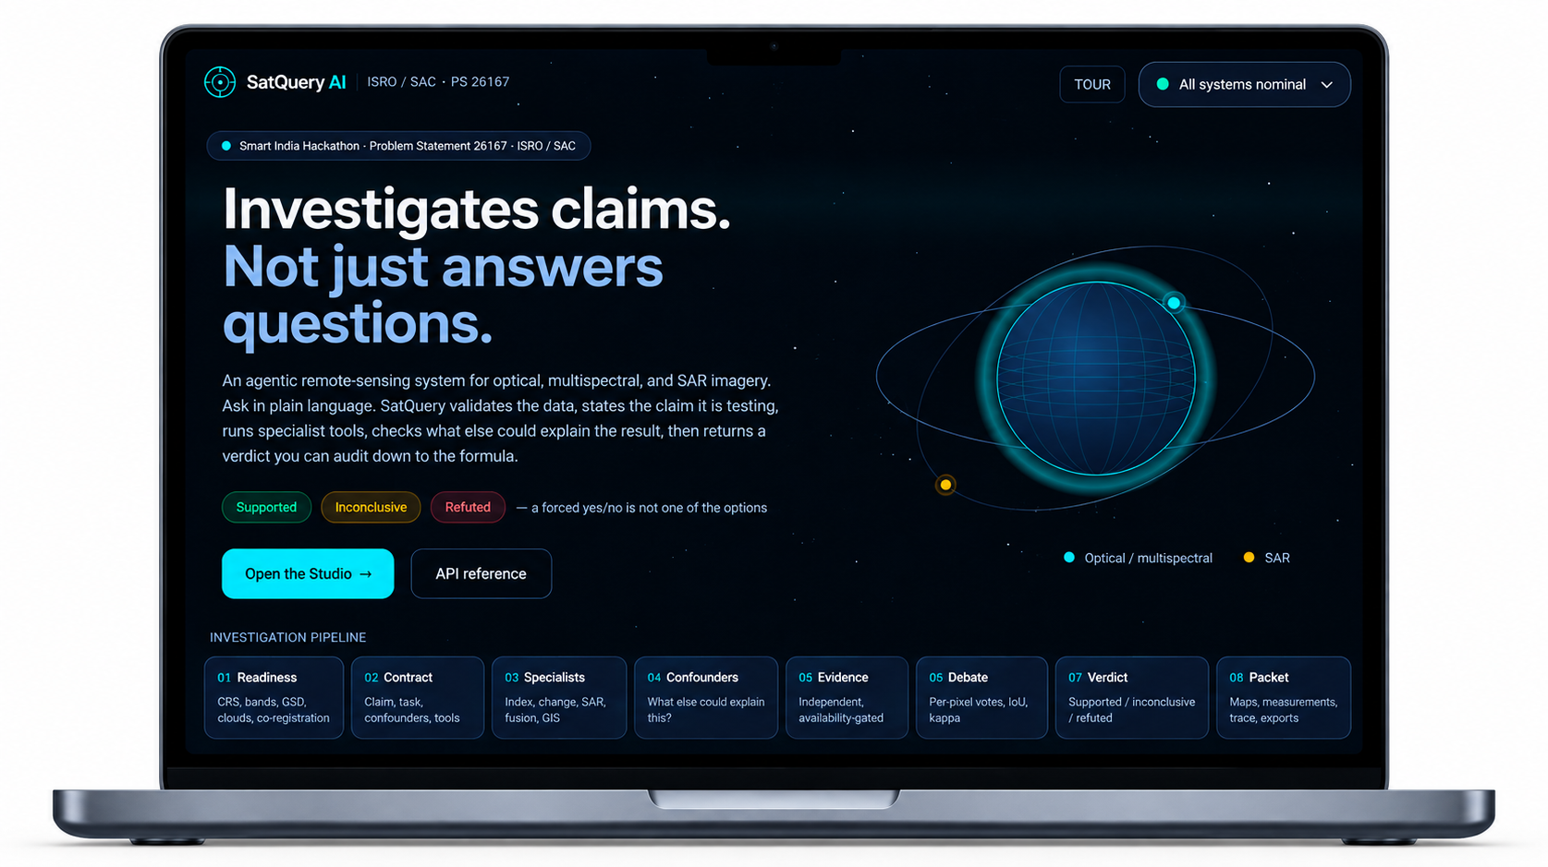
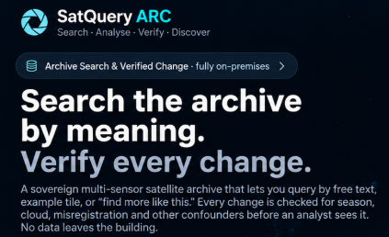
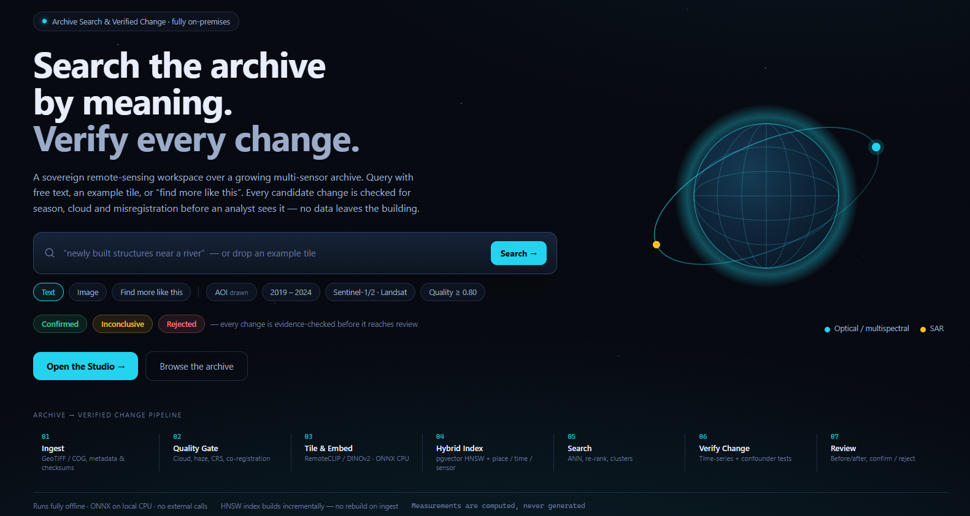
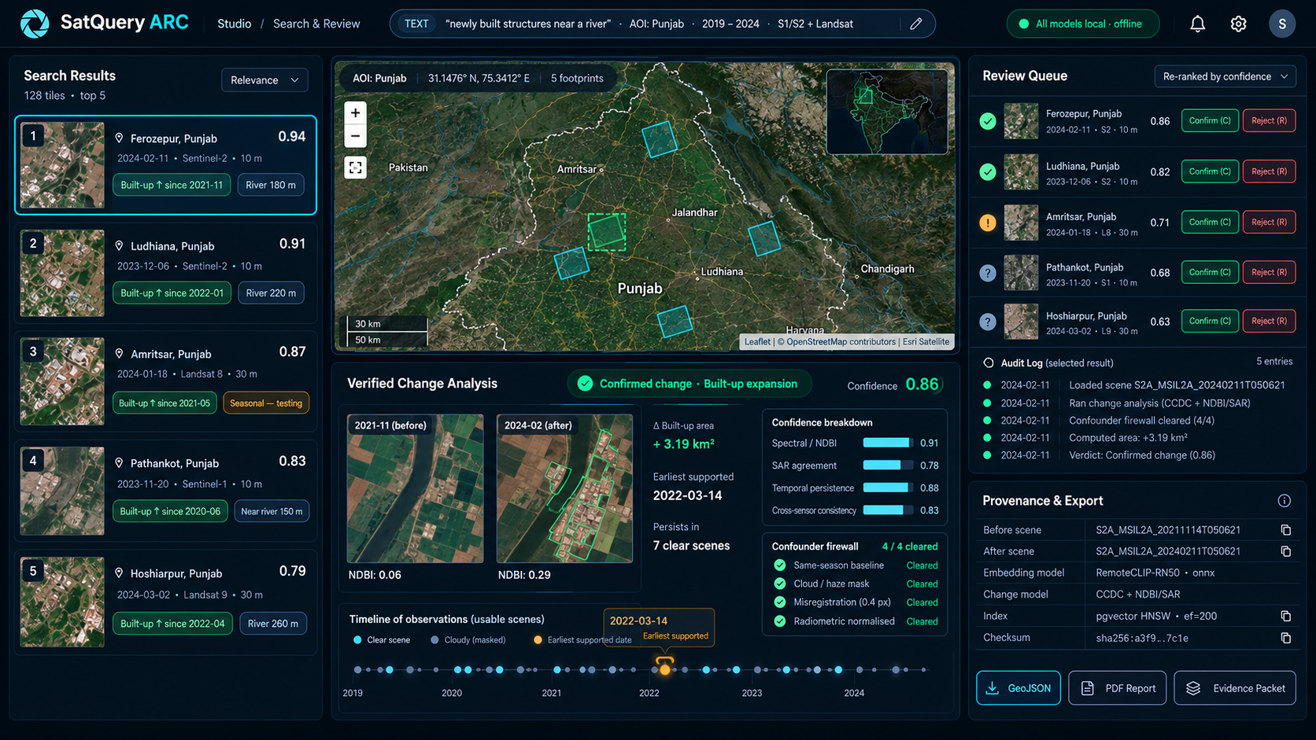
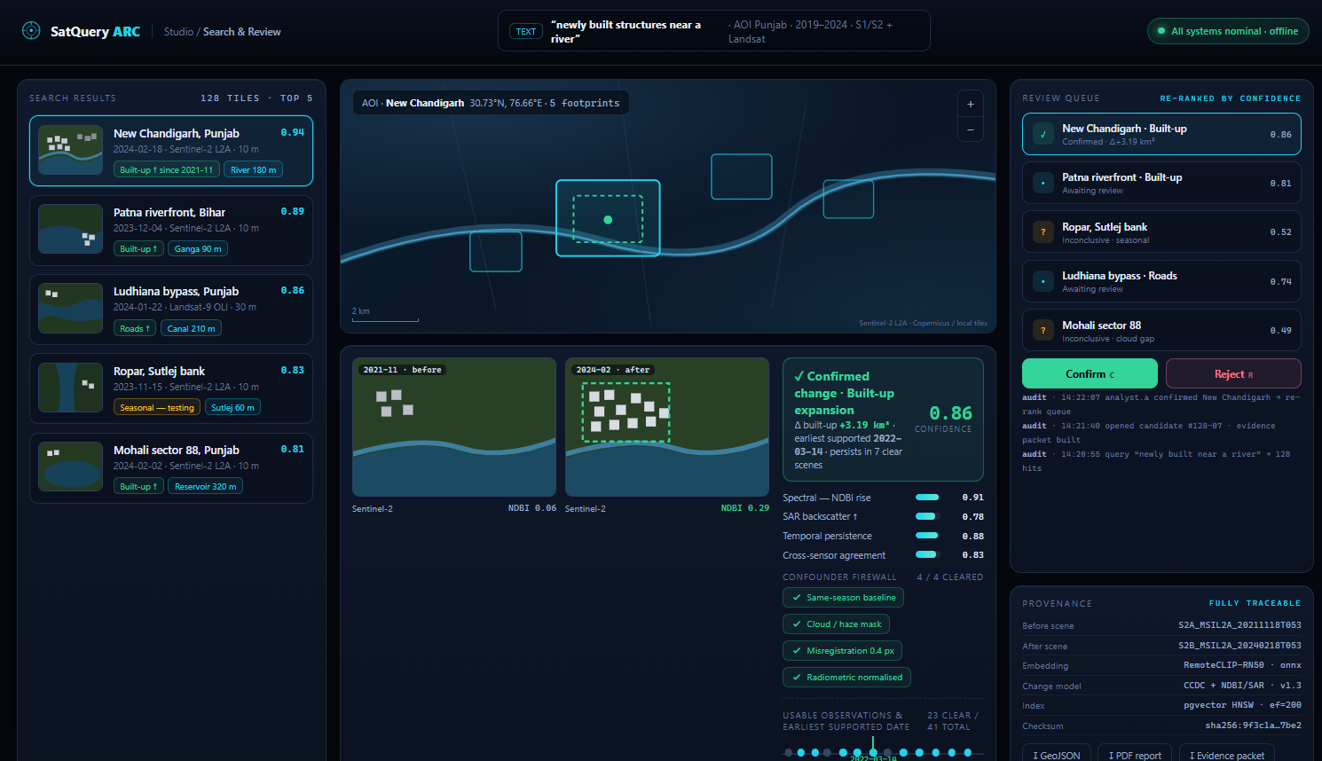
RESEARCH AND REFERENCES
Byte Bandits
SATQUERY ARC – UI Design
RESEARCH FOUNDATION
OUR CONTRIBUTIONS
RemoteCLIP
CCDC
COMPOSITIONAL SEARCH
"Newly built near a river" becomes an object,
timed, placed and ranked offline.
How We Use It
CONFOUNDER FIREWALL
Season, illumination, cloud, radiometry and
registration are eliminated before any alerts.
Text-to-tile search,
zero-shot concepts.
Seasonal model of
every clear pixel.
EARLIEST SUPPORTED DATE
Image-to-image
similar-site search.
A change must persist in subsequent clear
Earliest-date
change estimate.
images before it can be dated to the earliest
observation showing it.
REFERENCES
Core Technical Focus
RemoteCLIP (IEEE TGRS 2024) – arXiv:2306.11029
CCDC (RSE 2014) – doi:10.1016/j.rse.2014.01.011
HNSW (Malkov & Yashunin) – arXiv:1603.09320
SSL4EO-S12 – arXiv:2211.07044
CLIP trained on RS
image-text pairs.
Harmonic fit on all
usable observations.
Apache-2.0 weights,
runs fully offline.
Change proven by
persistent anomalies.
Website Hosted URL – https://satquery-arc.vercel.app
YouTube Demo URL –
Research

